Slide 1

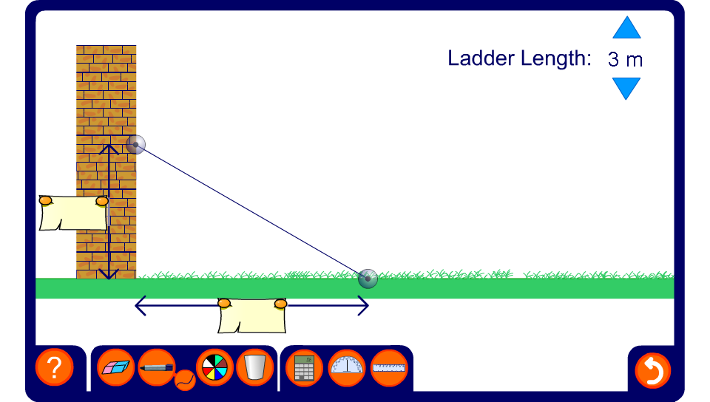


Ladder problem
Notes:
Change the length and the position of the ladder to generate various problems.

